Slide 1
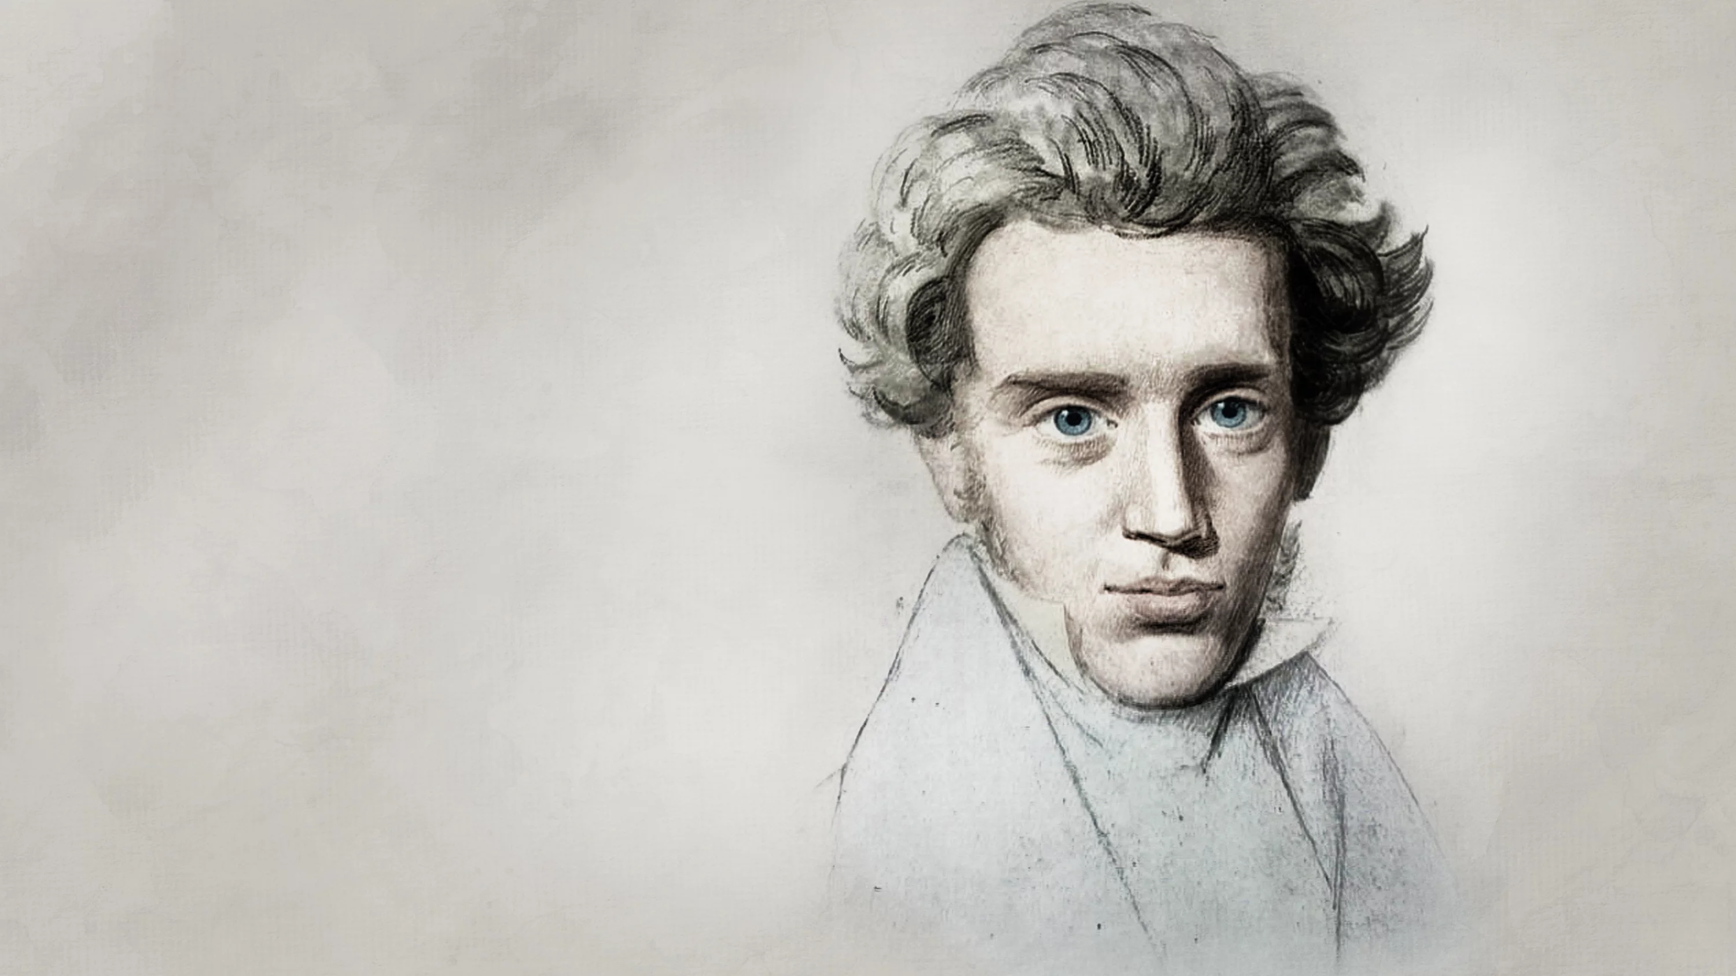
Søren Kierkegaard
Gentrain 12
MPC

Slide 2
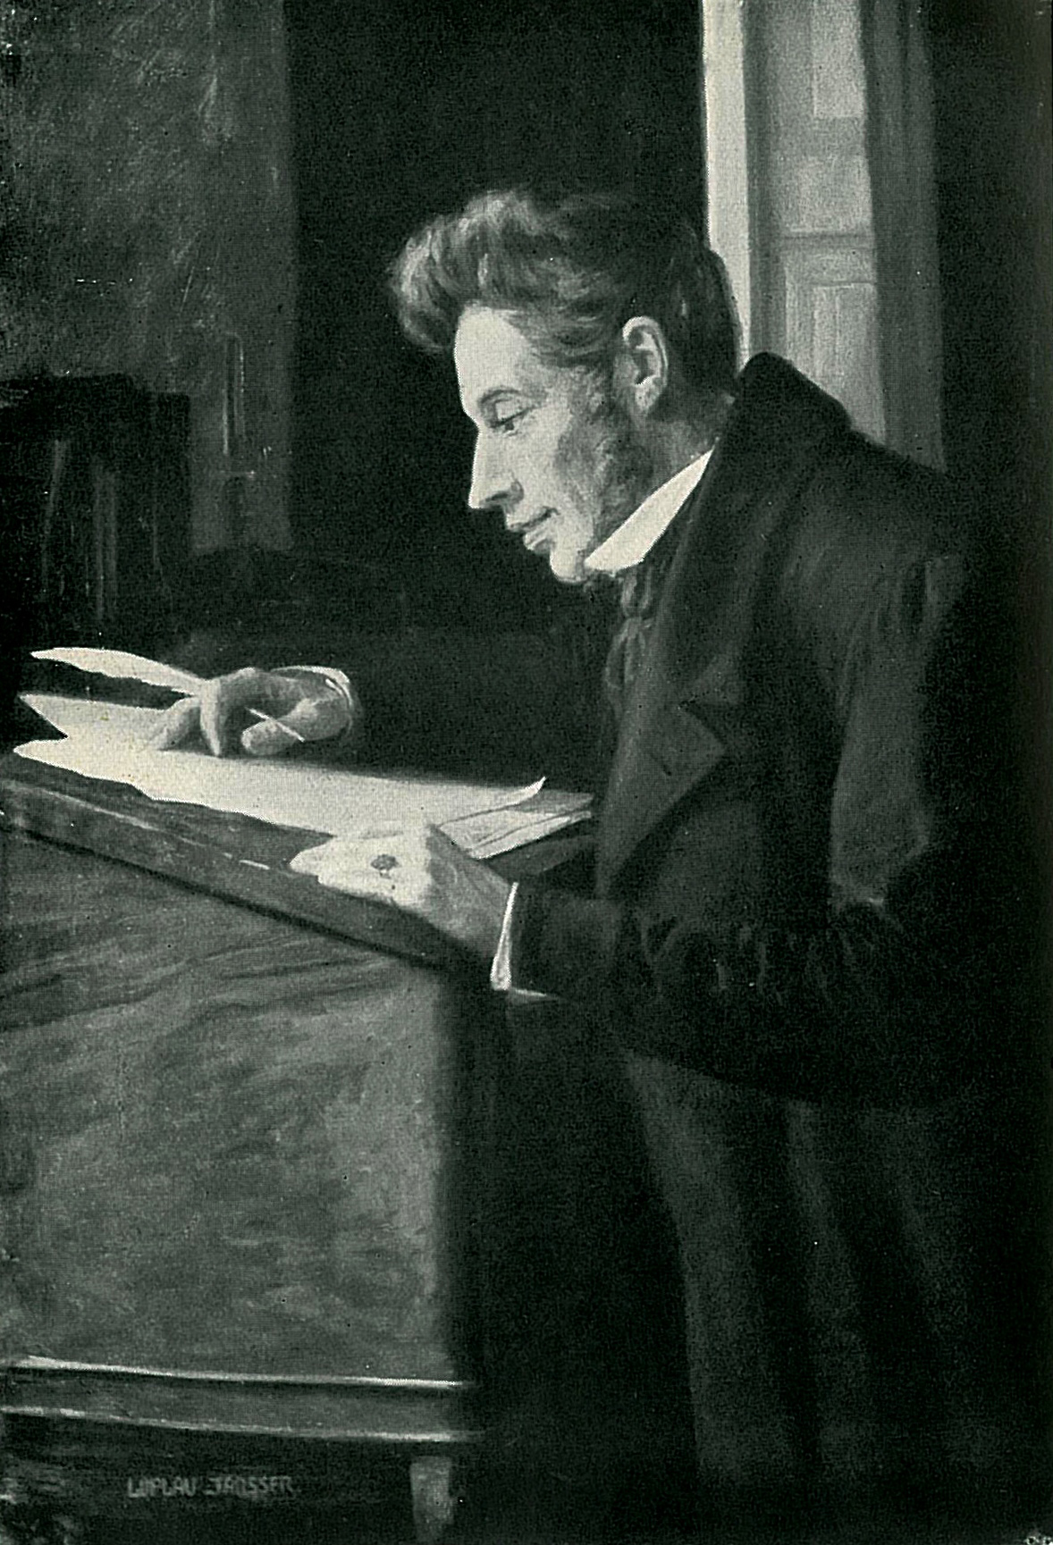
Kierkegaard
Kierkegaard (1813-1855) from Denmark
Philosopher, poet, theologian, social critic
First existential philosopher (The Father of Existentialism)
Wrote on morality, ethics, psychology, organized religion, Christianity, philosophy of religion
Literary in style: used literary devices such as metaphor and irony often → included parables
Concerned with how to live as an individual → prioritizes concrete lived reality over abstract thinking
Highlights important of personal choice

Slide 3
Christian Ethics
Not all work is religious in nature → but a great bulk of his work is
Such as Fear and Trembling and The Anxiety of Influence
These works are concerned with the problem of anxiety and the contrast between the inner world of spirit and the outer world of ethics
Writes on the institution of the church → critical of Christianity as a state-controlled religion (like in Denmark)
Differences between the various proofs of Christianity and God’s existence
Individual relationships (both must come through faith):
Between man and God
Individual’s subjective relationship to Christ as God-Man
Concern with the theory and practice of Christian love and the feelings of individuals when confronted with life choices.

Slide 4
Objectivity/Subjectivity
Early work: used various pseudonyms to present different and distinct viewpoints and have them in discuss issues
About the subjective experience of the individual
Science v. Christianity as objective/subjective: "Science and scholarship want to teach that becoming objective is the way. Christianity teaches that the way is to become subjective, to become a subject” (Concluding Unscientific Postscript, Hong trans., 1992, p. 131)
While scientists can learn about the world by observation, Kierkegaard emphatically denied that observation alone could reveal the inner workings of the world of the spirit.
Key concepts include discussion of "subjective and objective truths"

Slide 5
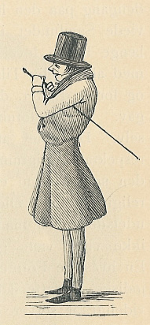
Influence
Wrote philosophical works in Danish → meant that his earliest readers were limited to Scandinavia
By 20th century writings had been translated into French, German, and other major European languages
This is when we start to see his influence in twentieth century philosophy → by the middle of the century his influence was substantial
Especially after the 1930s when existential philosophers named him as influence
A caricature of Kierkegaard published in the satirical journal The Corsair

Slide 6
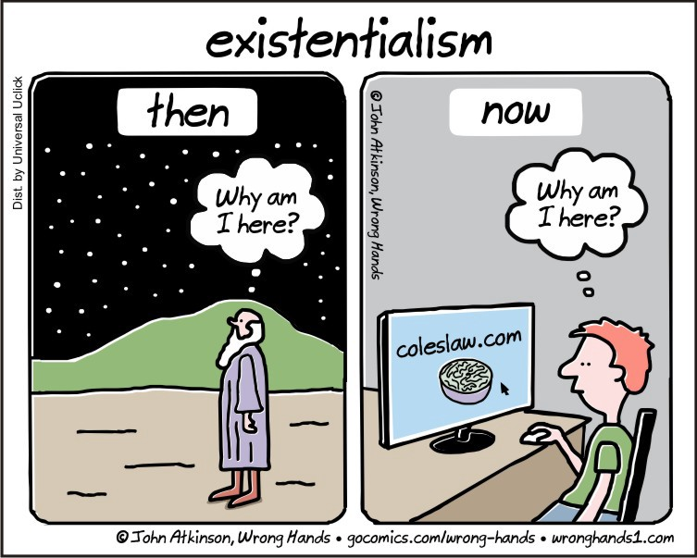
The Father of Existentialism
Considered to be the first existentialist philosopher
Claimed that each individual is responsible for giving meaning to life and then living that meaning authentically
Opposed to the idea that society or religion gives meaning to the individual
Existentialism: “Existentialism is the philosophical belief we are each responsible for creating purpose or meaning in our own lives. Our individual purpose and meaning is not given to us by Gods, governments, teachers or other authorities” (The Ethics Center)
The individual’s starting point is “existential angst”: the sense of dread, confusion, disorientation in the face of meaningless world
Asks questions about the meaning of existence, in a post-objectivist world

Slide 7
The “Leap of Faith”
Leap of faith: how an individual would believe in God or act in love
Faith and religious belief is not a decision an individual makes based on evidence centered around the idea that certain beliefs about God are true or that a certain person is worth of love
This is because there is no evidence that would be enough to totally justify the kind of complete commitment required for true religious faith or romantic love
Faith: requires that complete total commitment → but to have faith is at the same time to have doubt
To truly have faith in God, they would also have to have doubts about their beliefs → doubt is the rational part of thought involved in assessing evidence
Without doubt, faith has no real substance.
The person without faith, who is merely credulous: Someone who does not experience doubt or who doesn’t realize that Christian doctrine is inherently doubtful → that there can be no objective certainty about truth
Physical objects require no faith: no faith required to believe in the existence of the pencil when experiencing it directly.
To have faith or belief in God is to also know that there is no perceptual access to God, yet you still believe.
Kierkegaard: "doubt is conquered by faith, just as it is faith which has brought doubt into the world".

Slide 8
The self, the world, and truth
Self-reflection/introspection: the foundation of the self and the self’s relation to the world
“Subjectivity is truth” and “truth is subjectivity.”
This relates to the distinction between what is objectively true and an individual’s subjective relationship to that truth → for example, if someone is indifferent to that truth or committed to it
Two people with the same set of beliefs might still relate to those beliefs very different
For example, both may believe that there are those around them who are poor and deserve help → this knowledge might only compel one of the two to actually help the poor

Slide 9
Abstract thinking and concrete existence
Kierkegaard does not deny the fruitfulness or validity of abstract thinking (science, logic, and so on), but he does deny any superstition which pretends that abstract theorizing is a sufficient concluding argument for human existence. He holds it to be unforgivable pride or stupidity to think that the impersonal abstraction can answer the vital problems of human, everyday life. Logical theorems, mathematical symbols, physical-statistical laws can never become patterns of human existence. To be human means to be concrete, to be this person here and now in this particular and decisive moment, face to face with this particular challenge.
— C Svere Norborg, David F. Swenson, scholar, teacher, friend. Minneapolis, The University of Minnesota, 1940, pp. 20–21

Slide 10
Subjectivity and religion
The primary purpose for his work on subjectivity is to apply it to religious issues
Doubt important to faith → no objective certainty about religious doctrine such as the existence of God or the life of Christ
If reassurance is what one is looking for in philosophy: the most one will get is the conclusion that it might be true that Christian doctrines are true
But if someone were to believe the doctrines only to the degree that they are likely to be true, then they are not a genuinely religious person
faith: the subjective relation of absolute commitment to these doctrines even in the face of doubt

Slide 11
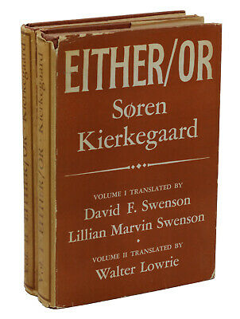
Either/Or
The first work of Kierkegaard that was published
Appeared in two volumes in 1843 → published pseudonymously under the editorship of Victor Eremita (Latin: “victorious hermit”)
Work explores two theories of human existence: the hedonistic/aesthetic mode vs. the ethical/committed life
Portrays two life views → each view is written and represented and argued by a fictional pseudonymous author
The writing style of each volume/work reflects and depends on the life view being discussed.
Aesthetic view: written in short essay form, with poetic imagery, allusions, discussing aesthetic topics such as music, seduction, beauty, and drama
Ethical life: written as two long letter with more restrained prose → concerned with moral responsibility, critical reflection, and the importance of marriage
Expressed as lived experiences rather than neatly summarized viewpoints

Slide 12
Either/Or: Aesthetic v. Ethical Life
Aesthetic: personal and subjective world → individual lives and experiences pleasure for their own sake → possibility of both the highest and the lowest life
Ethical: external life of civic engagement → one’s value and identity are judged by the exterior objective world
One can decide whether to remain oblivious to the world and its goings on or become involved.
Begins with the conscious effort to choose one’s life
Whichever way the individual decides to go, they shouldn’t go to far or else they will lose sight of their true self
Only faith can rescue them from these two different sides
Kierkegaard challenges the reader to to "discover a second face hidden behind the one you see“ in him/herself first, and then in others.

